Slide 1
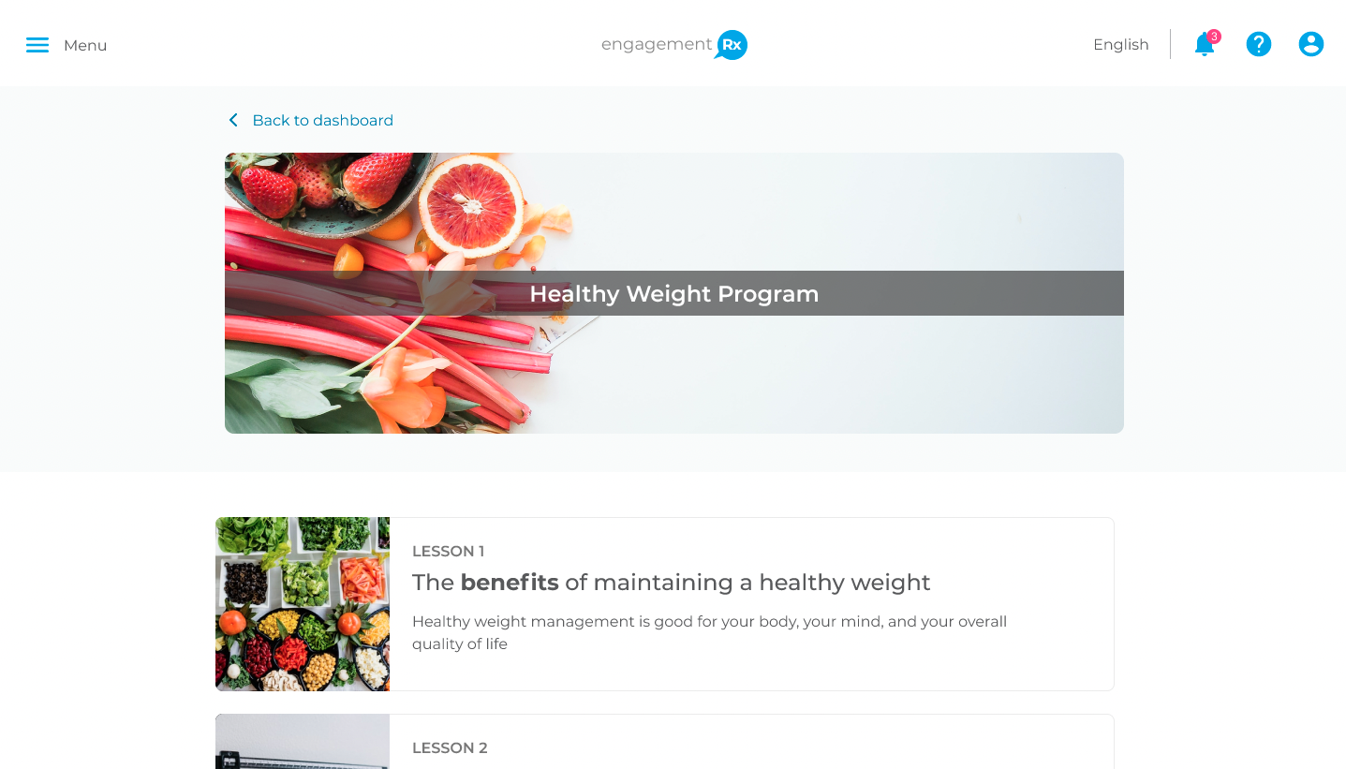
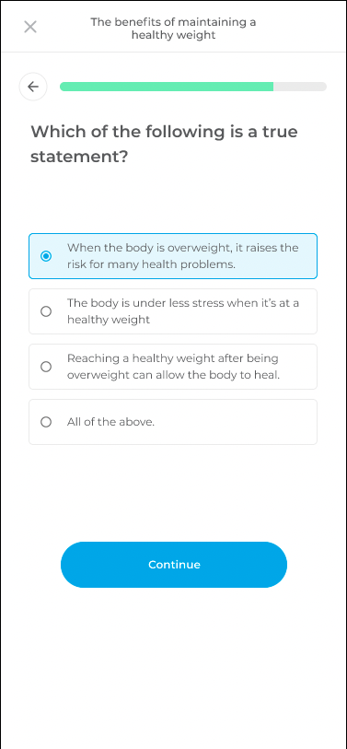
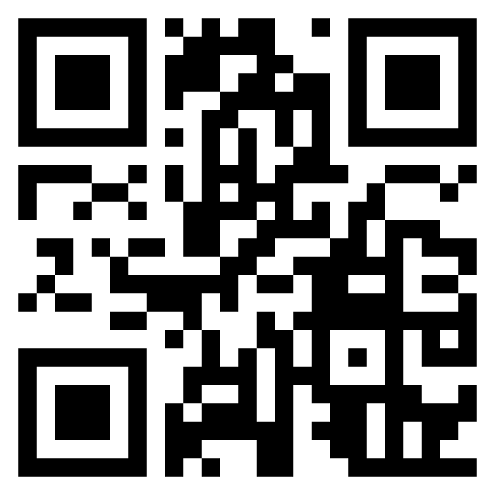
Changing habits is hard. We make it easier.
People just like you are transforming their lives every day with Avidon. Scan the QR code to get started.
Comprehensive Courses: 25+ programs targeting stress, sleep, fitness, weight management, nutrition, substance use, & more.
Engaging Challenges: Build momentum and stay inspired with monthly wellness challenges that turn healthy habits into fun experiences.
Curated Resources: 700+ articles, videos, and audio guides designed to inspire and inform.
or visit member.avidonhealth.com

Slide 2
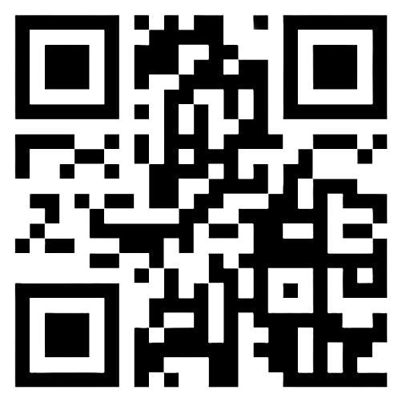
All Your Health Goals,
One Simple Solution
From sleep to stress, nutrition, parenting, productivity, healthy aging, and beyond—Avidon’s comprehensive cognitive behavioral programs, wellness challenges, trackers, and engaging content empower you to thrive.
Start Your Wellness Journey!
Scan the QR Code or Click the Link
Log In or Create Your Account
Pick a Course or Challenge & Begin
Notes:
Content Overview

Slide 3
Ready to Transform Your Health?
Want to feel your best, every day?
From stress to nutrition, sleep to fitness, Avidon provides comprehensive cognitive behavioral programs, wellness challenges, and trackers that empower lasting health.
Achieve Your Health Goals!
Scan the QR Code or Click the Link
Log In or Create Your Account
Pick a Course or Challenge & Begin
Notes:
General

Slide 4
Find Your Calm,
Build Your Strength
Ready to experience more calm and resilience? Avidon’s cognitive behavioral programs, wellness challenges, and trackers help you proactively nurture your mental and emotional health.
Your Path to Emotional Health
Make meaningful changes daily
Be proactive with self-care
Discover your purpose
Boost Your Wellbeing Now!
Scan the QR Code or Click the Link
Log In or Create Your Account
Pick a Course or Challenge & Begin
Notes:
Mental Health and Welbeing

Slide 5
From Stress to Refreshed
Stress doesn’t have to control your day. Avidon’s powerful self-guided courses, wellness challenges, trackers, and expert content give you practical tools to quickly lower stress, build resilience, and feel calm again.
24/7 Stress Support
Identify your stress triggers
Learn effective coping strategies
Build lasting resilience-Practical steps to managing stress
Start Feeling Better Now!
Scan the QR Code or Click the Link
Log In or Create Your Account
Pick a Course or Challenge & Begin
Notes:
Stress Management

Slide 6
Eat Smarter, Feel Better
Only 9% of adults get enough veggies.
Avidon’s cognitive behavioral training, wellness challenges, and trackers make healthy eating simple, realistic, and sustainable.
Start Eating Better Today!
Scan the QR Code or Click the Link
Log In or Create Your Account
Pick a Course or Challenge & Begin
Notes:
Healthy Eating

Slide 7
Stop Tossing,
Start Sleeping!
Struggling with sleepless nights? Avidon’s cognitive behavioral programs, wellness challenges, trackers, and content help you break the insomnia cycle and finally get restful sleep.
Better Sleep Starts Here
Understand why you struggle with sleep
Discover sleep-friendly nutrition tips
Create habits that restore restful sleep
Unlock Better Sleep Tonight!
Scan the QR Code or Click the Link
Log In or Create Your Account
Pick a Course or Challenge & Begin
Notes:
Sleep

Slide 8
Get Energized...
YOUR Way!
Tired of feeling tired? Avidon’s powerful self-guided courses, wellness challenges, health trackers, and motivating content help you transform exercise from a chore into something you enjoy.
Energize Your Life Now!
Scan the QR Code or Click the Link
Log In or Create Your Account
Pick a Course or Challenge & Begin
Notes:
Physical Activity

Slide 9
Break the Cycle, Take Back Your Life
Recognize emotional triggers and learn strategies to break free of substances. Avidon’s cognitive behavioral programs, wellness challenges, trackers, and content give you actionable steps to regain control.
End the Dependence
Scan the QR Code or Click the Link
Log In or Create Your Account
Pick a Course or Challenge & Begin
Notes:
Substance Use

Slide 10
Clear the Air – Quit
for Good!
Ready to finally break free from nicotine? Avidon’s proven self-guided cognitive behavioral programs, wellness challenges, and supportive content help you crush cravings and reclaim control.
Quit Nicotine on Your Terms
Overcome cravings without feeling deprived
Recognize and reframe smoking triggers
Destroy self-defeating thoughts
Quit Today!
Scan the QR Code or Click the Link
Log In or Create Your Account
Pick a Course or Challenge & Begin
Notes:
Nicotine Cessation

Slide 11
Ready to Rethink Your Drink?
Rewire Your Relationship with Alcohol
Worried you're drinking too much? Avidon’s cognitive behavioral approach helps you reshape your relationship with alcohol and reclaim control.
Scan the QR Code or Click the Link
Log In or Create Your Account
Pick a Course or Challenge & Begin
Notes:
Alcohol

Slide 12
You Control Your Condition, It Doesn’t Control You
70% of people managing chronic diseases report stress. Avidon’s cognitive behavioral training, wellness challenges, and trackers help you feel empowered to manage your condition effectively.
Master Your Condition
Build empowering habits
Simplify condition management
Reach health and life goals
Get Empowered Today!
Scan the QR Code or Click the Link
Log In or Create Your Account
Pick a Course or Challenge & Begin
Notes:
Chronic Disease Management

Slide 13
Ditch Dieting—Change Your Mindset
Struggling with cravings and diets that fail? Avidon’s powerful self-guided courses, wellness challenges, and trackers help you permanently change your habits, mindset, and relationship with food.
Transform Your Habits
Stop cravings without relying on willpower
Break unhealthy thought cycles
Identify hidden triggers behind habits
End Cravings Today!
Scan the QR Code or Click the Link
Log In or Create Your Account
Pick a Course or Challenge & Begin
Notes:
Weight Management

Slide 14
Stop Running Dry!
Did you know 75% of Americans are dehydrated? Avidon’s cognitive behavioral programs, wellness challenges, and trackers make hydration simple, effective, and realistic.
Hydration Simplified
Easily incorporate water into your routine
Balance hydration for optimal health
Stay hydrated without hassle
Hydrate for Better Health!
Scan the QR Code or Click the Link
Log In or Create Your Account
Pick a Course or Challenge & Begin
Notes:
Hydration

Slide 15
Stop Stressing,
Start Saving
Financial stress significantly impacts mental health. Avidon’s cognitive behavioral training, wellness challenges, and trackers help you confidently manage your finances, reduce anxiety, and achieve financial security.
Financial Freedom Starts Here
Understand the basics of financial wellness
Discover tips and strategies to instantly save money
Learn skills for tackling debt and maintaining good credit
Gain Financial Freedom!
Scan the QR Code or Click the Link
Log In or Create Your Account
Pick a Course or Challenge & Begin
Notes:
Financial

Slide 16
Thinking About GLP-1s? Get the Facts
Considering GLP-1 medications for weight loss? Avidon’s cognitive behavioral programs and content help you explore potential lifestyle changes, set realistic expectations, and offer empowerment for those already in GLP-1 treatments as well as those thinking about it.
Get Clear Answers Now!
Scan the QR Code or Click the Link
Log In or Create Your Account
Pick a Course or Challenge & Begin
Notes:
GLP-1

Slide 17
Feeling Disconnected? Reconnect Now.
Avidon’s cognitive behavioral programs, wellness
challenges, and trackers help you build meaningful relationships and reduce loneliness.
Connect Today!
Scan the QR Code or Click the Link
Log In or Create Your Account
Pick a Course or Challenge & Begin
Notes:
General

